Slide 1

Internship Project
Presentation
on
VERACITIZ SOLUTION
By
Group ID: G06
ARYAN MODI
[20162121011]
Under the guidance of
PROF. DHARMESH DARJI JACKY PATEL
HEAD , CSE DEPARTMENT REPORT MANAGER
Institute of Computer Technology, Ganpat University
Date: 11 May 2024

Slide 2


WEEK 1
ETL PROCESS
WEEK 2
SQL SERVER MANAGMENT STUDIO
WEEK 3
Slowly Changing Dimantion
WEEK 4
SingleStore
Table of Content
WEEK 5
HACKERRANK
WEEK 6
IMPROVE LOGIC BULDING SKILL
WEEK 7
IMPROVE LOGIC BUILDING SKILL
PRO
LIVE PROJECT
PRO
THANK YOU
02

Slide 3
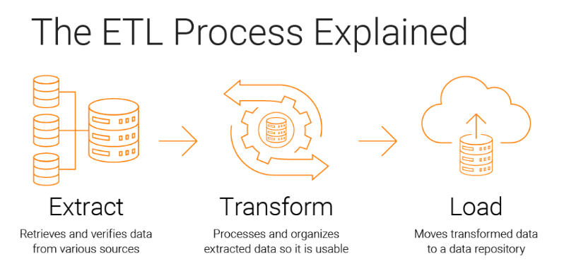
Week 1
15-01 to 21-01

Slide 4
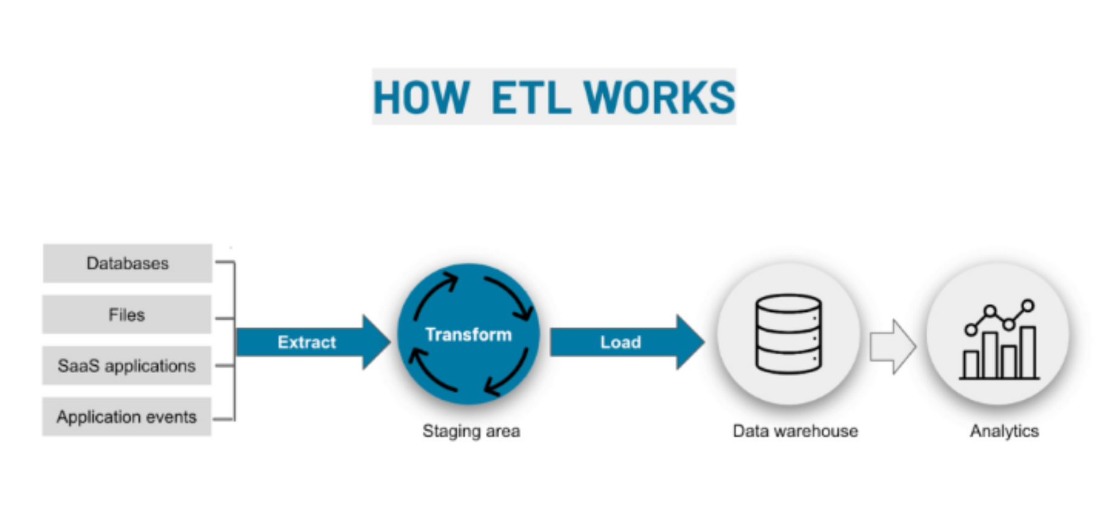
•I have learn following concepts : brief introduction of ETL ,DATA ,Data Warehouse , SQL Concepts , ALTER , MODIFY , CHANGE , CONSTRAINT , RENAME , MIN-MAX , WHERE , AGGRIGATE functions and STRING functions , ORDER BY ,GROUP BY , JOINJS , DATE other task are mantion in the documents.

Slide 5


Week 2
22-01 to 28-01

Slide 6
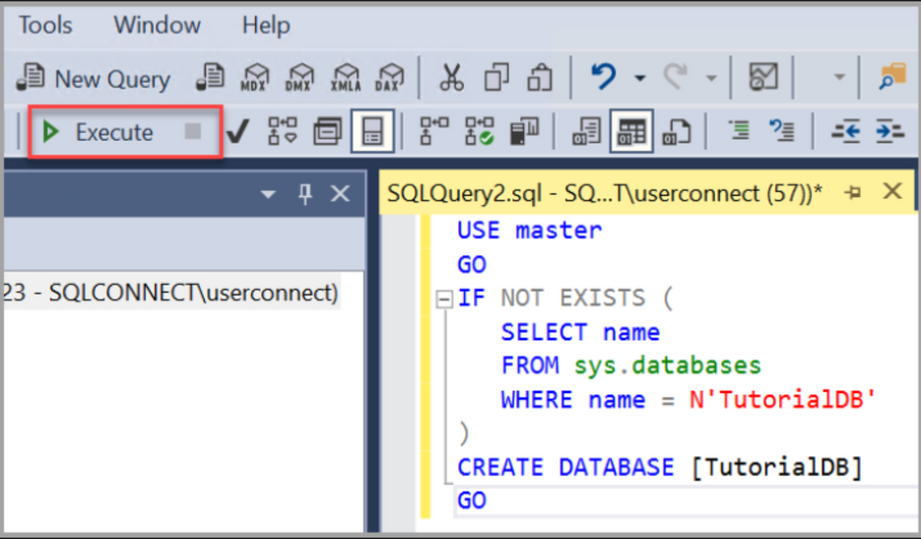
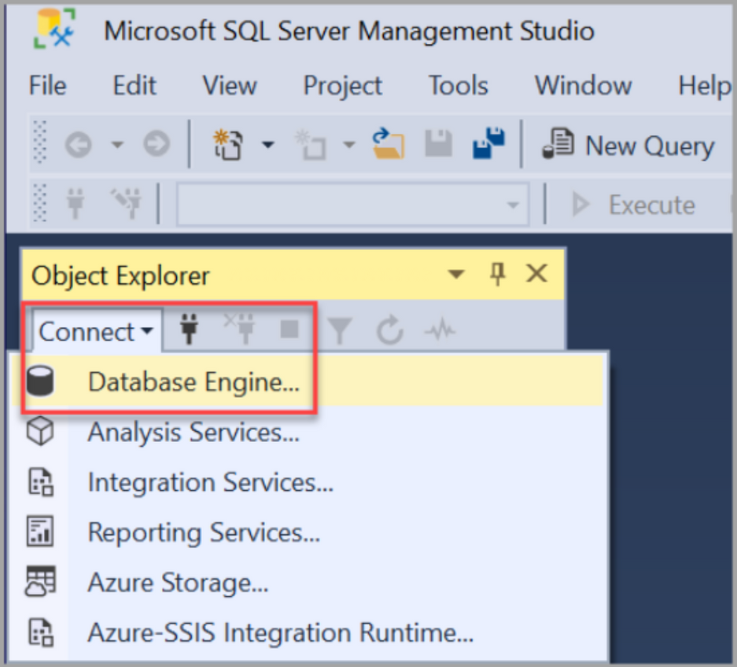
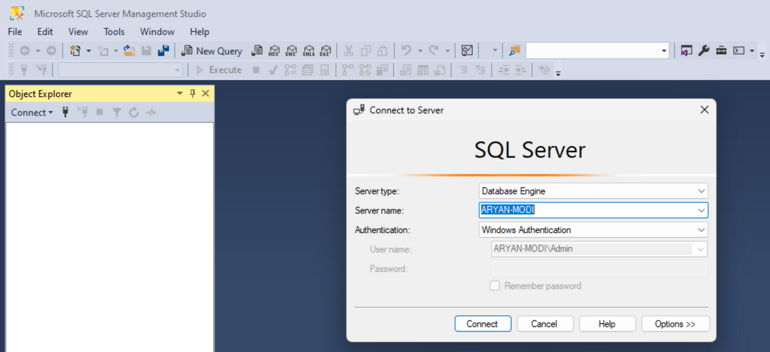
•I have learn following concepts : RANK , DENSE RANK , Difference of both, Sub Quary, RANK and DENSE RANK with condition , LEAD & LAG FUNCTIONS , it's task ,STRING SPLIT functions , logic building tasks which are mentioned in Document.

Slide 7
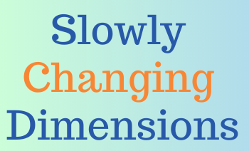
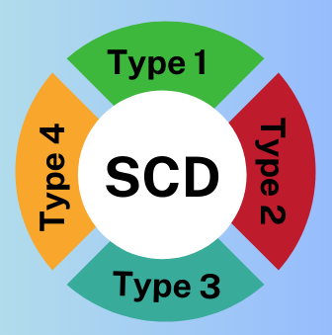
Week 3
29-01 to 04-02

Slide 8
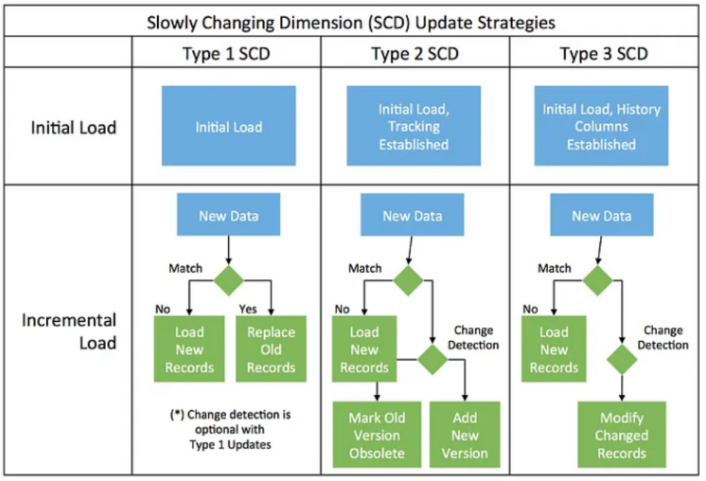
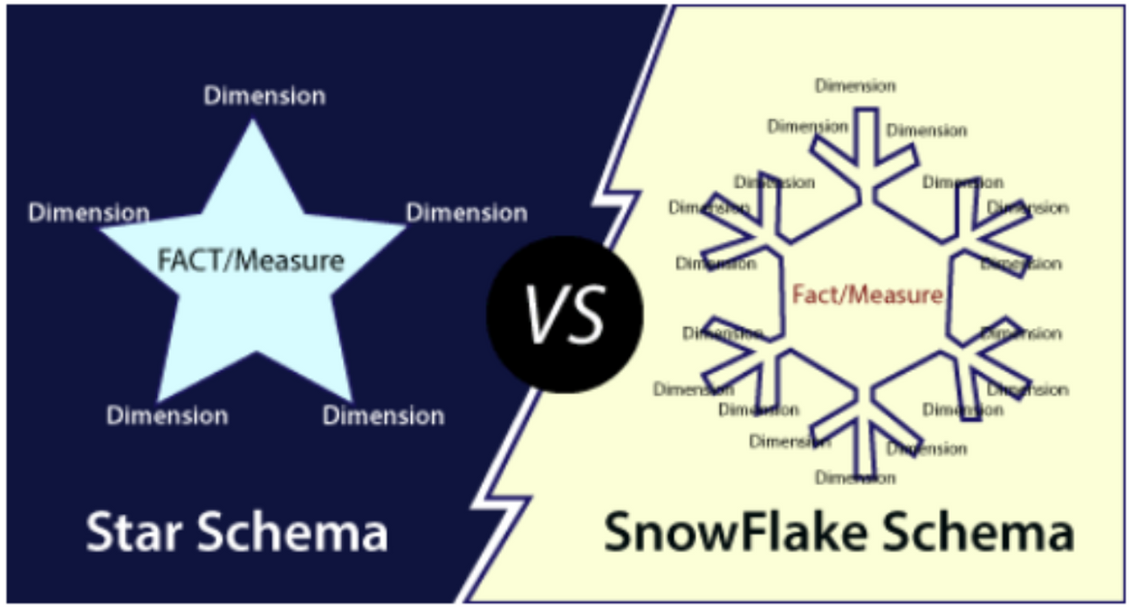
•I have learn following concepts :SCD (Slowly Changing Dimension) and windows functions , Slowly Changing Dimension SCD type 1 examples with different scenarios , Slowly Changing Dimension SCD type 2 and SCD type 3 examples with different scenarios , DATABASE , DATA WAREHOUSE , STAR SCHEMA , SNOW FLAKE SCHEMA , GALAXY SCHEMA , DATA MART.

Slide 9

Week 4
05-02 to 09-02

Slide 10

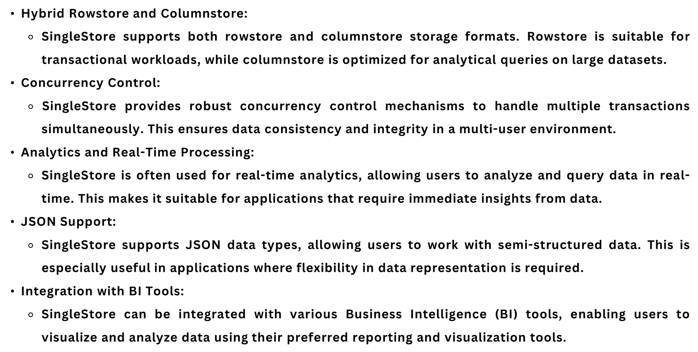

Slide 11
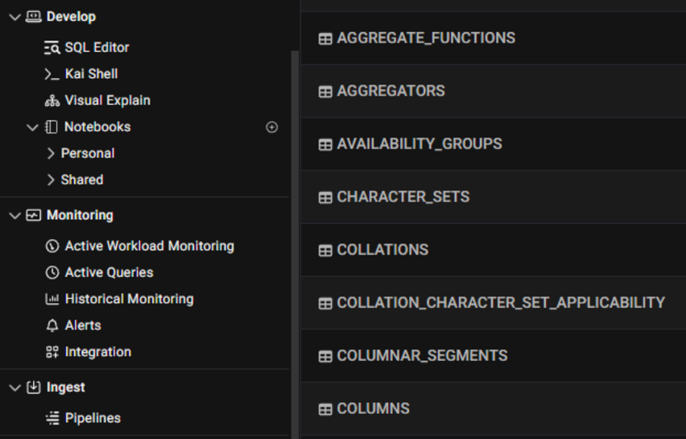
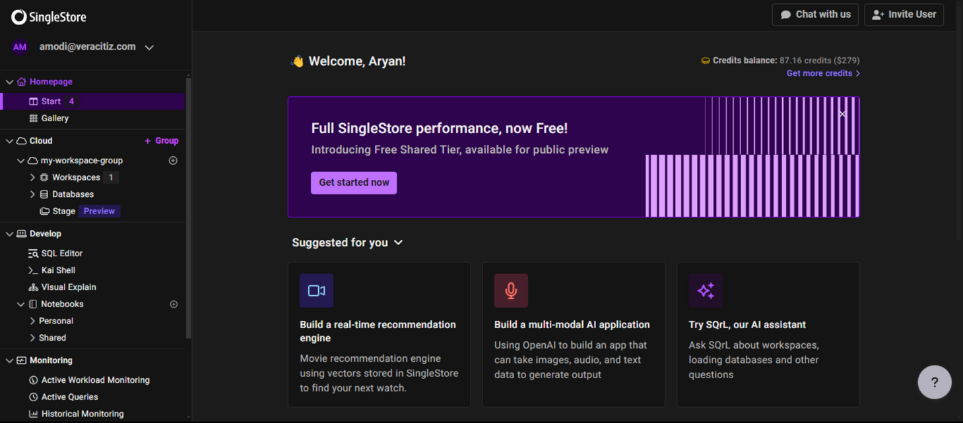
I have leant about SINGLE STORE installation process , how singlestore works , Shard Key , Data Skew , High Availability , type of Table and singlestore tools , SINGLE STORE installation process with cloud version and connect it with MySQL Workbanch , Indexing , Type of Indexing , Views , SPLIT and Store it in to new column Assignment and I have many Methods to implement dynamic way to store it ,interval table with dates which are mentation in Document. In Extra , work on HackerRank problem solving tasks.

Slide 12

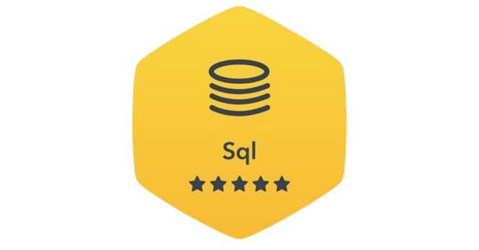
Week 5
12-02 to 16-02

Slide 13
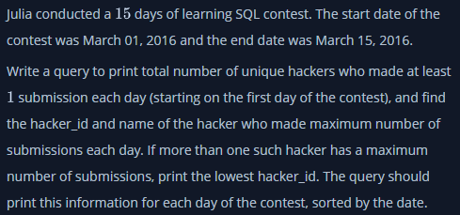
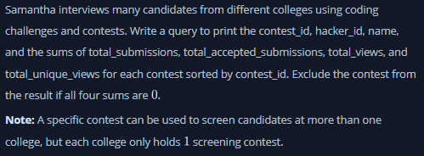
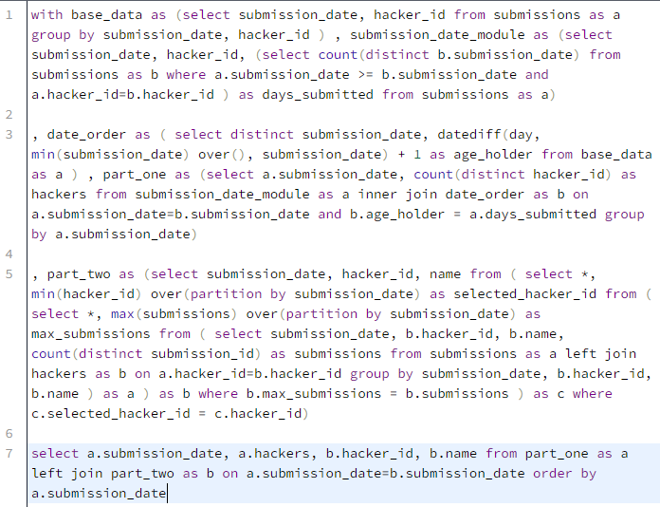
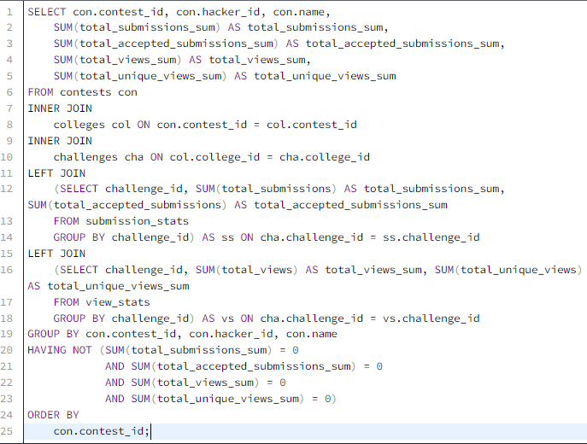
I have work on HackerRank problem solving tasks.

Slide 14

Week 6
19-02 to 23-02

Slide 15
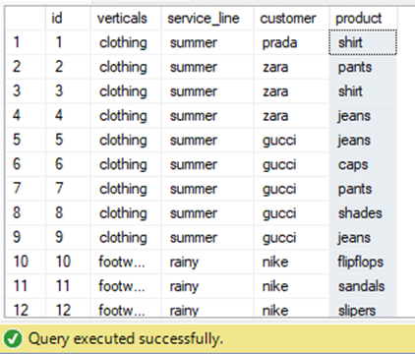
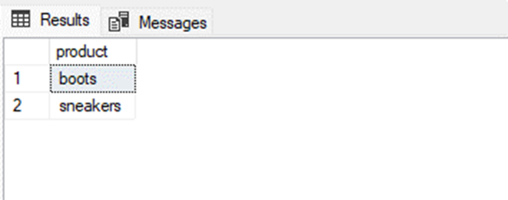
-- Create procedure
CREATE PROCEDURE RecommendProductsByCustomer
@input_customer VARCHAR(50)
AS
BEGIN
-- Declare variables
DECLARE @verticals VARCHAR(20);
DECLARE @service_line VARCHAR(20);
-- Select verticals and service_line into variables
SELECT @verticals = verticals, @service_line = service_line
FROM recomendation_sys
WHERE customer = @input_customer;
-- Check if customer and vertical/service line exist
IF (@verticals IS NULL OR @service_line IS NULL)
BEGIN
PRINT 'Customer or vertical/service line not found';
RETURN; -- Exit the procedure
END;
SELECT distinct(product) FROM recomendation_sys WHERE product NOT IN
(SELECT product FROM recomendation_sys WHERE customer = @input_customer) AND
verticals IN (SELECT verticals FROM recomendation_sys WHERE customer = @input_customer) AND
service_line IN (SELECT service_line FROM recomendation_sys WHERE customer = @input_customer)
END
GO
EXEC RecommendProductsByCustomer @input_customer = 'nike';
I have work on task regarding procedure , subquery , logic building task which mentation in document. I have leant about singlestore architecture , Demo: Recognizing Faces Using a SQL Database , SingleStore Architecture Overview and Product Demo , Demo: Recognizing Faces Using a SQL Database , Revenue Split Level 1 and learn about mapping and join ,cricket data and explore Singlestore and perform PIVOTE and SPLIT STRING functions , worked on SQL Logic Building which mention in document.

Slide 16
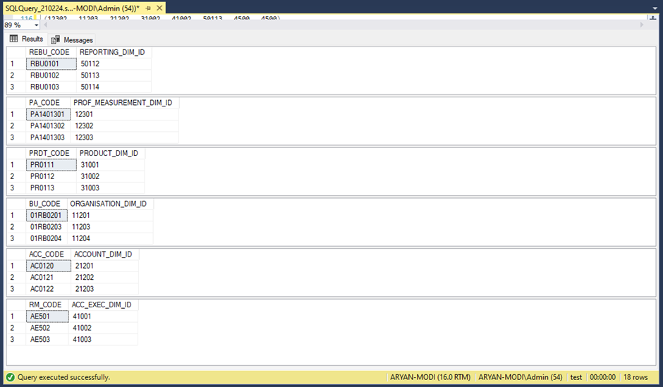
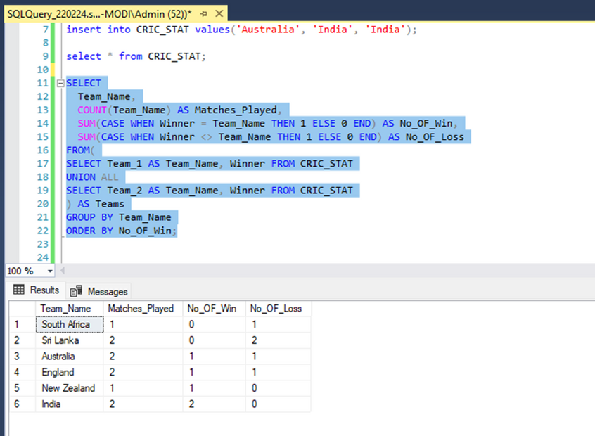
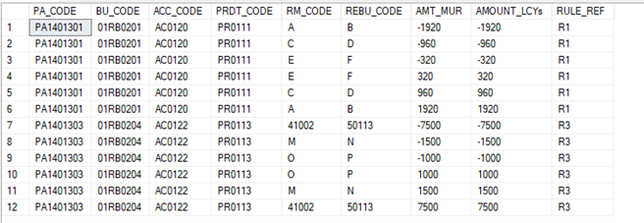
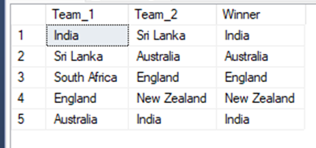

Slide 17

Week 7
26-02 to 01-03

Slide 18
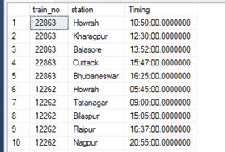
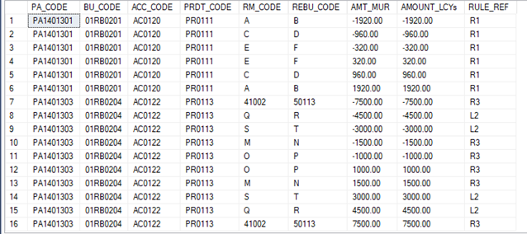
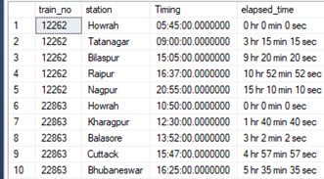
I have worked on SQL Logic Building sequence data and advance windows functions example , Revenue Split Level 2 task. , Revenue Split Level 1 and 2 task dynamic approach and Team Hierarchy split data , Transection and Account SCD Data , Bank DATA population. Generate DATA of bank CR/DR details.

Slide 19
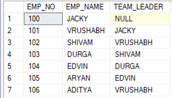
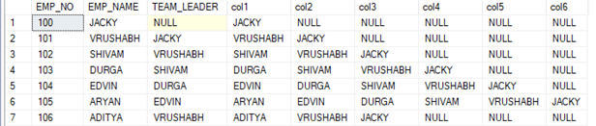
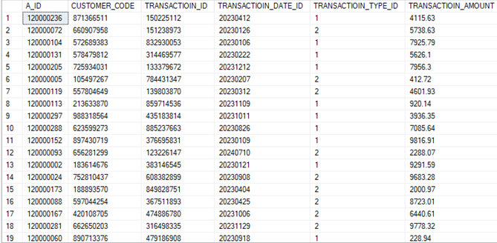
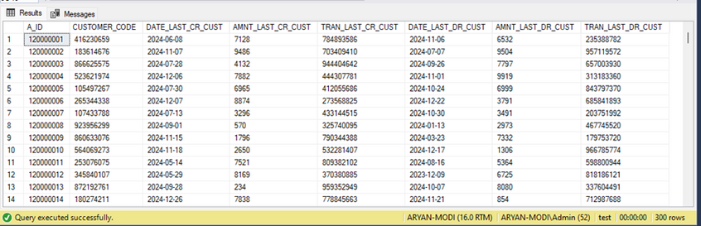
DECLARE @counter_tr INT = 1
WHILE @counter_tr <= 10000
BEGIN
DECLARE @A_ID_tr BIGINT = (SELECT TOP 1 A_ID FROM DIM_ACCOUNT ORDER BY NEWID())
DECLARE @CUSTOMER_CODE_tr BIGINT = (SELECT TOP 1 CUSTOMER_CODE FROM DIM_ACCOUNT WHERE A_ID = @A_ID_tr)
DECLARE @TRANSACTION_ID_tr INT = ABS(CHECKSUM(NEWID())) % 900000000 + 100000000
DECLARE @TRANSACTION_DATE_ID_tr INT =
YEAR(DATEADD(DAY, -CAST(RAND() * 365 as INT), GETDATE())) * 10000 +
MONTH(DATEADD(DAY, -CAST(RAND() * 365 as INT), GETDATE())) * 100 +
DAY(DATEADD(DAY, -CAST(RAND() * 365 as INT), GETDATE()))
DECLARE @TRANSACTION_TYPE_ID_tr INT = ABS(CHECKSUM(NEWID())) % 2 + 1
DECLARE @TRANSACTION_AMOUNT_tr FLOAT = ROUND(RAND() * 10000, 2)
INSERT INTO SRC_TRAN (A_ID, CUSTOMER_CODE, TRANSACTIOIN_ID, TRANSACTIOIN_DATE_ID, TRANSACTIOIN_TYPE_ID, TRANSACTIOIN_AMOUNT)
VALUES (@A_ID_tr, @CUSTOMER_CODE_tr, @TRANSACTION_ID_tr, @TRANSACTION_DATE_ID_tr, @TRANSACTION_TYPE_ID_tr, @TRANSACTION_AMOUNT_tr)
SET @counter_tr = @counter_tr + 1
END

Slide 20





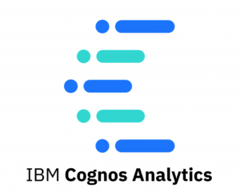

LIVE PROJECT
LOOP
SQL

Slide 21
LOOP SQL
In SQL Server, a loop is the technique where a set of SQL statements are executed repeatedly until a condition is met.
SQL (Structured Query Language), loops are constructs used to iterate over a set of data or perform repetitive tasks.
Unlike traditional programming languages like Java or Python, SQL doesn't have built-in looping constructs like "for" or "while" loops.
However, there are methods available in SQL to achieve similar iterative functionality, such as cursors and recursive queries.
JavaScript
JavaScript is a versatile programming language commonly used for building interactive web applications.
Event Handling:- JavaScript is frequently used to handle user interactions such as clicks, key presses, form submissions, etc. You can define event listeners that trigger functions when specific events occur on HTML elements.
DOM Manipulation:- JavaScript allows you to dynamically update the content and styles of HTML elements on a webpage. You can manipulate the Document Object Model (DOM) using functions to add, remove, or modify elements.
AJAX Requests:- JavaScript enables asynchronous communication with a server using AJAX (Asynchronous JavaScript and XML) requests. You can define functions to send HTTP requests to a server and handle the responses without reloading the entire page.
Error Handling:- JavaScript allows you to handle runtime errors and exceptions gracefully using try-catch blocks. You can define functions to catch and handle errors to prevent them from crashing the entire application.

Slide 22
node JS
Node.js is widely used for building web servers due to its non-blocking, event-driven architecture. Frameworks like Express.js make it easy to create robust and scalable web applications.
API Development:- Node js is ideal for building RESTful APIs to provide data and services to client-side applications. You can define routes, handle requests, and interact with databases using libraries like Mongoose or SQL databases.
Real-time Applications:- Node js, along with frameworks like Socket.io, is used for building real-time web applications that require bidirectional communication between clients and servers.
Microservices:- Node js is well-suited for building microservices architecture, where small, independent services communicate with each other to perform specific tasks. This allows for better scalability, maintainability, and deployment flexibility.
FIREVASE
Firebase is a comprehensive platform provided by Google for building web and mobile applications. It offers a variety of services that can be used individually or together to streamline the development process.
Realtime Database:- Firebase Realtime Database is a NoSQL cloud database that stores and syncs data between your users in real-time. It's ideal for building collaborative and real-time applications such as chat apps, collaborative editing tools, etc.
Hosting:- Firebase Hosting provides fast and secure hosting for your web app, including SSL encryption, CDN integration, and automatic deployment from a Git repository. It's ideal for hosting static websites, single-page apps, and progressive web apps.
Cloud Functions:- Firebase Cloud Functions allows you to run server-side code in response to events triggered by Firebase features and HTTPS requests. You can use it to extend your app's functionality, integrate with third-party services, and automate tasks.

Slide 23
Ngrok
Ngrok is a service that creates secure tunnels to your localhost, exposing it to the internet. It's often used by developers during the development and testing phase of web applications or APIs. This allows them to share their work with others or test functionality across different devices without deploying it to a public server.
Tunneling: Ngrok establishes secure tunnels from a public endpoint (e.g., ngrok.io) to a port on your local machine. This means you can expose a local server running on your machine to the internet without having to deploy it to a public server.
Security: Ngrok tunnels are secure, utilizing TLS encryption for data transfer. This means that data transmitted between your local machine and the ngrok server is encrypted.
Subdomains: Ngrok allows you to reserve a subdomain under ngrok.io for your account, making it easier to remember the URL for your tunnels.
Inspecting traffic: Ngrok provides a web interface where you can inspect the HTTP traffic passing through the tunnel in real-time. This can be helpful for debugging and monitoring purposes.
Authentication and custom domains: Ngrok offers features like HTTP basic authentication for added security, and you can also use custom domains if you’re on one of their paid plans.
Integration with Development Tools: Ngrok seamlessly integrates with various development tools and frameworks commonly used by developers, such as Node.js, Python, Ruby on Rails, and more. This integration streamlines the process of setting up tunnels and testing web applications or APIs during development.
Dynamic Port Forwarding: Ngrok's ability to dynamically assign a public URL to a local port simplifies the process of exposing multiple services running on different ports simultaneously. This flexibility is particularly useful for developers working on complex projects with multiple components.

Slide 24
Cognos
IBM Cognos, Custom Controls are a way to extend the functionality of the report authoring environment by allowing developers to create custom user interface components. These components can be integrated into Cognos reports to enhance interactivity, visualization, or data manipulation capabilities beyond what's provided by default.
Purpose: Custom Controls allow developers to create custom user interface elements or components that can be embedded within Cognos reports. These components can range from simple input fields to complex interactive visualizations.
Development: Custom Controls are typically developed using web technologies such as HTML, CSS, and JavaScript. Developers can leverage libraries like jQuery or D3.js to create rich and interactive components.
Integration: Once developed, Custom Controls can be integrated into Cognos reports using the Report Studio authoring tool. They are added to reports just like any other report item, such as tables or charts.
Functionality: Custom Controls can provide a wide range of functionality, including custom input forms, interactive charts and graphs, data filters, and more. They can interact with Cognos data sources and respond to user actions within the report.
Flexibility: Custom Controls offer flexibility in terms of design and functionality, allowing developers to tailor them to specific reporting requirements or user preferences.
Deployment: Custom Controls need to be deployed to the Cognos server environment so that they can be used within reports. This typically involves uploading the control files to the appropriate directories on the Cognos server.
Integration with Cognos Reports: Custom Controls are integrated into Cognos reports through the use of Report Studio, which is the report authoring tool in IBM Cognos.
Documentation and Support: IBM provides documentation, tutorials, and forums to help developers learn how to create and integrate Custom Controls effectively.

Slide 25
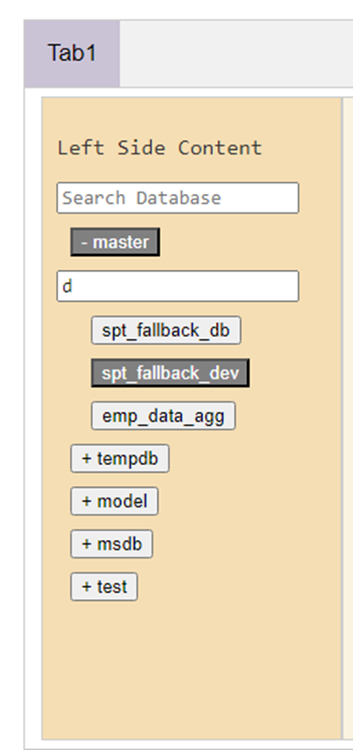
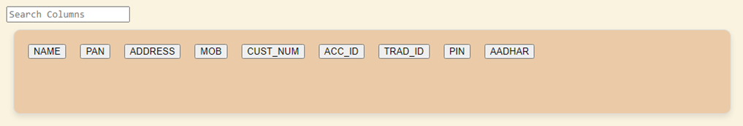
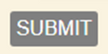
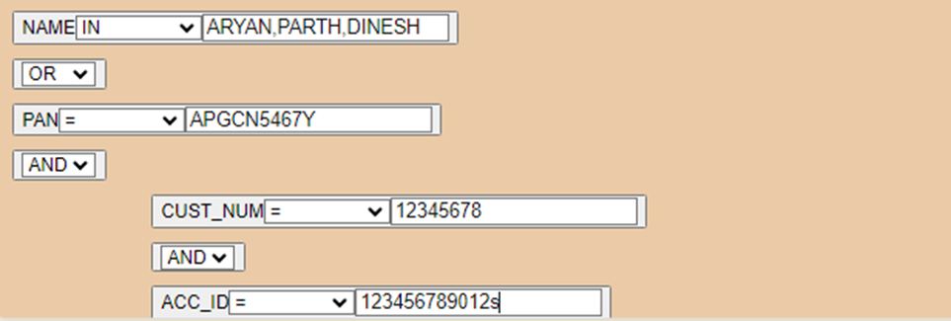
SCREENSHOTS

Slide 26
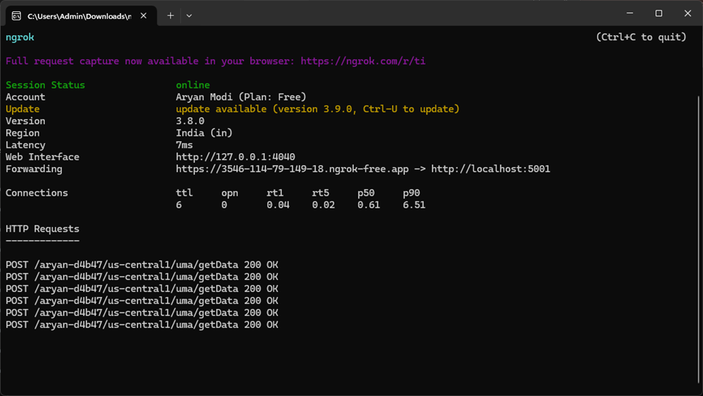
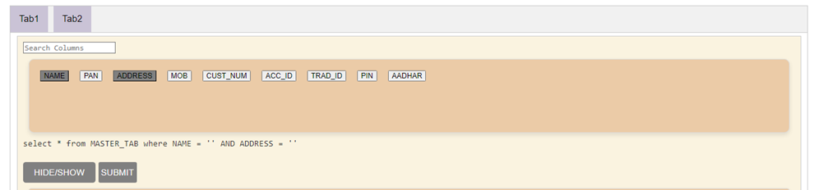
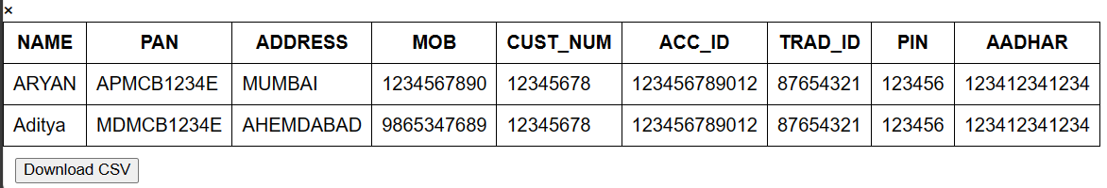
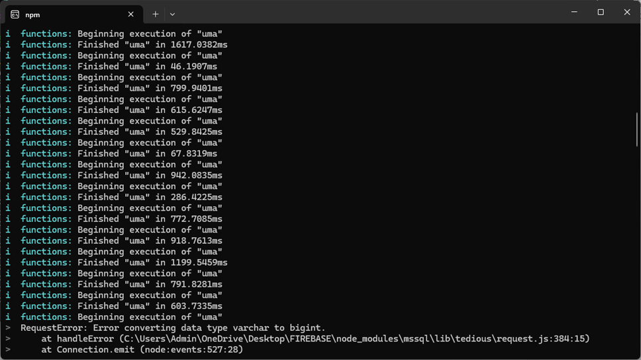
SCREENSHOTS

Slide 27


Thank you!
ARYAN MODI
Feel free to reach out to us if you have any questions.
Phone Number
Email Address
Website
+91 94293 26003
amodi@veracitiz.com
www.veracitiz.com

